Slide 1
IDENTIFYING AND REDUCING GENDER BIAS IN STEM
Dr. Matthew Paolucci Callahan (Psychology)
Dr. Lynn Cominsky (Physics and Astronomy)

Slide 2
After learning this material, you will be able to
1. Describe how gender stereotypes are activated automatically and unintentionally
2. Recognize and identify real life examples of overt and subtle gender bias in STEM
3. Practice how to respond to and reduce instances of gender bias

Slide 3
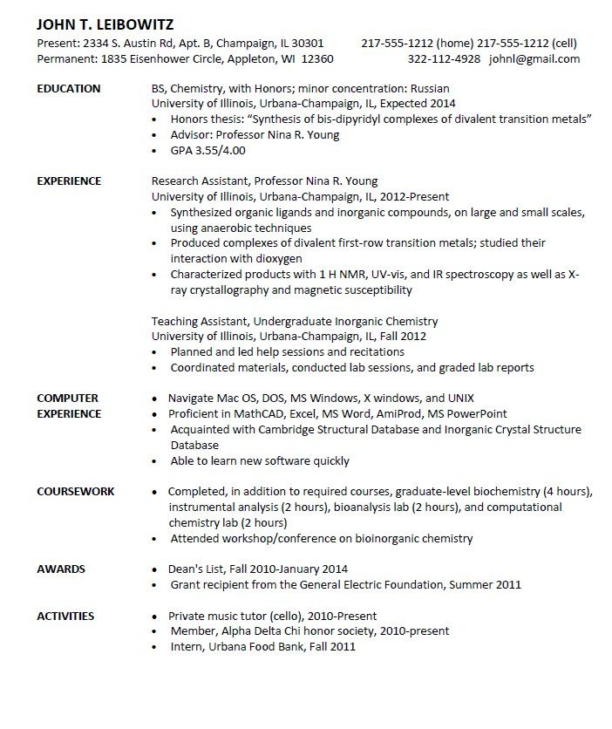
Imagine that John is applying for an entry level chemist

Slide 4
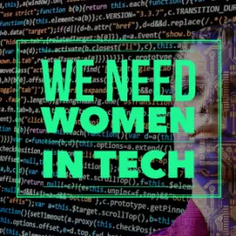
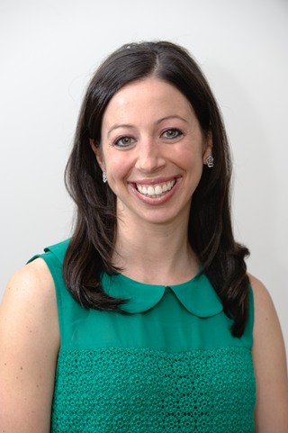
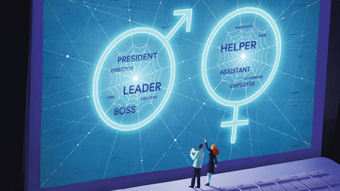
Social Psychologist Corinne Moss-Racusin’s research shows that if John was Julie…..
1. She’d be less likely to get the job
2. Even if she got the job, she would be brought in at a lower salary than John
Dr. Corinne Moss-Racusin
How do we know this? In her study, the resumes were identical, except for the name
Notes:
ASK THEM WHY? NOW DOES THUS MEAN THAT THESE SLIGHTS WERE PURPOSEFUL? Probably not. What is most likely happening is gender stereotype activation

Slide 5
What is gender bias, where does it come from, and what can we do about it?

Slide 6
Gender Bias is expressed in three ways
Stereotypes
Thoughts
Prejudice
(e.g. sexism)
Feelings
Behavior
(Gender discrimination)
Treatment
Notes:
Remember last week when I said attitudes come from three sources. Thoughts feelings and behaviors. Well prejudice is the same thing.

Slide 7
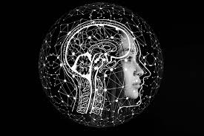
1. What are Stereotypes?
Stereotypes are thoughts

Slide 8
Think - “Tree”. What first pops into your head?
Even though “leaves” may automatically pop into our heads when we think “tree” not all trees have leaves!
Notes:
I am going t give you a word. And you are going to call out (or jot down) all of the attributes that pop into your mind after hearing the word. Don’t over think. This is not a trick question at all. J

Slide 9
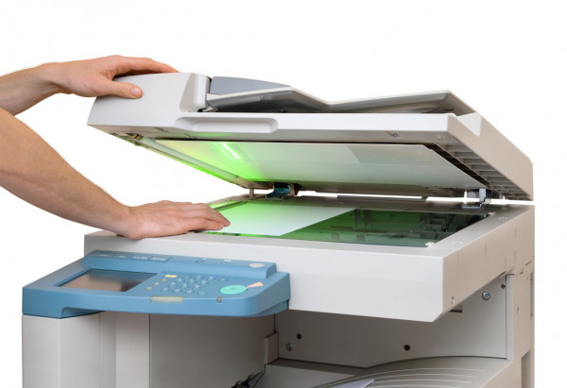
Stereotypes: “the pictures in our heads”
Scientist = male
Nurse = female
Notes:
GIVE EXAMPLES WITH THEM -

Slide 10
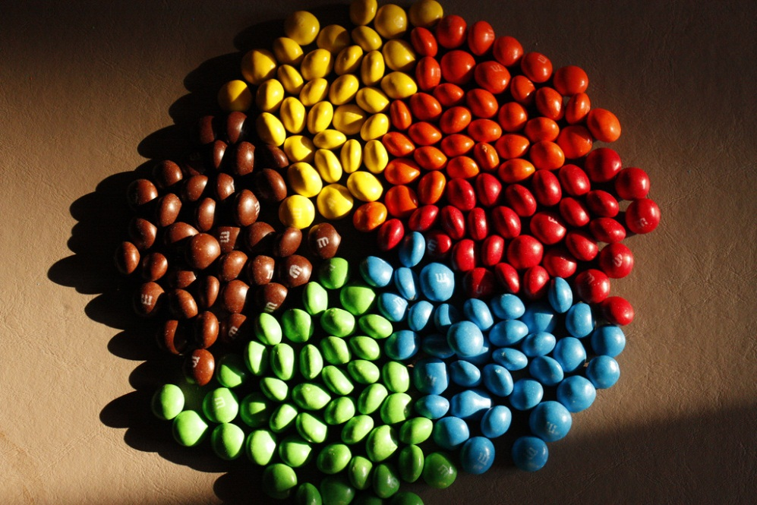
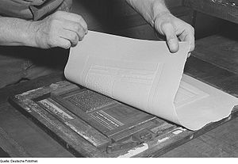
Categorization, then Stereotyping
Category
Stereotype
Notes:
Grouping/sorting into a category NON BINARY
Primary categories are
Age
Race
Gender*
Totally automatic
The shared attributes of the category
Men are tall
Asian people are smart
Elderly people are frail
Often elicited automatically but can be controlled.

Slide 11
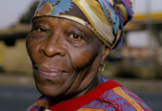
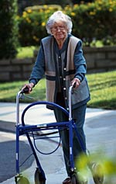
Categorization vs. Stereotypes
Categorization
Grouping/sorting into a category
Stereotype
The shared assumptions of the category
Notes:
CATEGORIZATION> Primary categories are
Age
Race
Gender
Totally automatic
STEREOTYPING
A generalization about a group of people in which certain traits are assigned to virtually all members of the group – regardless of actual variation among the members.
Men are tall
Asian people are smart
Elderly people are frail
Often elicited automatically but can be controlled.

Slide 12
Categorization – then automatic stereotyping (both automatic and unintentional)
Both share the same social category (professor)
How might their gender affect what is assumed about them?

Slide 13
What are Examples of Gender Stereotypes?
Masculine Traits
Confident
Competitive
Career-orientated
Logical
Leaders
Self-reliant
Ambitious
High self-esteem
Assertive
Decisive
Business sense
Feminine Traits
Warm and kind
Family-orientated
Emotional
Interest in children
Sensitive
Friendly
Clean
Attentive to appearance
Helpful
Polite
Cheerful

Slide 14
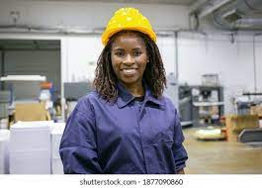
Gender Stereotypes are usually activated unintentionally, but then affect behavior (such as hiring)
But! The good news is that we can learn to catch ourselves when they are activated, and stop it from impacting behavior
“And it is not true. She would make a great engineer. Hire this woman!”
“I am noticing that this is in the back of my mind”
Notes:
Ask for examples

Slide 15
2. What are examples of how gender stereotypes can lead to sexism and gender discrimination in Science, Tech, Engineering and Math Disciplines? (STEM)

Slide 16
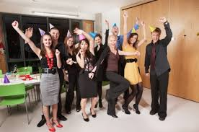
Sex role Spillover – when gender roles creep into work or class
Work Examples
“Do you babysit?”
Decorate the office/lab for parties
Notes:
Remember social role theory? Lets review. Gender roles stem from division of traditional labor: men as providers women as caregivers. Because of this these gender roles become diffuse and generalize to different social situations, one of them being work. This is sex role spill over: When gender role expectations sneak their way into the work place.
Can you plan the office party?
Would you mind making a pot of coffee?
Do you babysit?

Slide 17
Example. Sex role spillover over in class
Group Project Roles
Leader
Notetaker
Who leads the group?
Who takes notes?

Slide 18
Are gender stereotypes sneaking into “Rate My Professor” ratings?
Dr. Jones (Male) is
Smart
Brilliant
Cool
Intelligent
Boring
Arrogant
Dr. Jones (Female) is
Nice
Warm
Friendly
Sweet
Mean
Harsh
This research is summarized at http://benschmidt.org/profGender/#

Slide 19
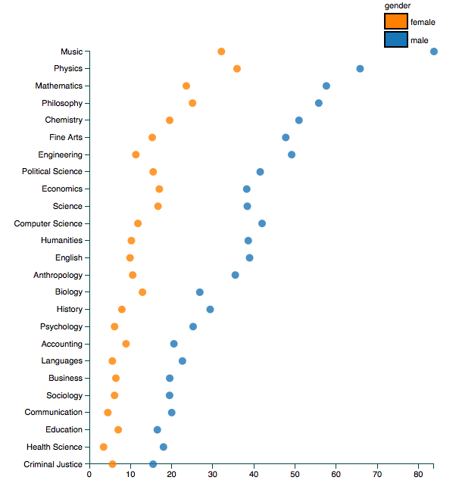
Results for a search of "genius" on the interactive chart show students are likelier to apply this word to their male professors.

Slide 20
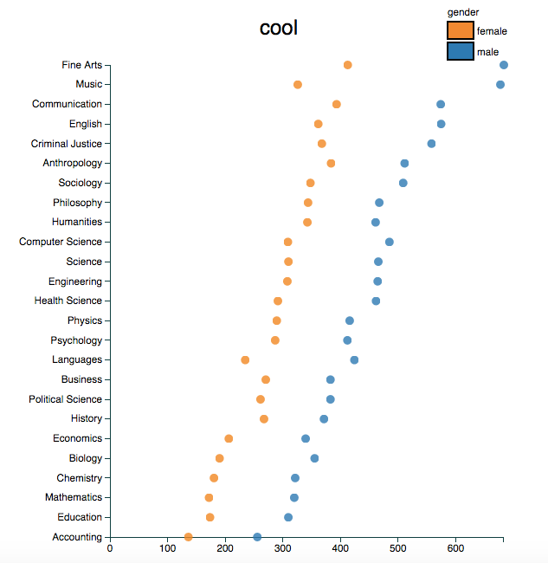
Results for a search of “cool" on the interactive chart show students are likelier to apply this word to their male professors.
Notes:
RUDE
Unfair
Smart
funny

Slide 21
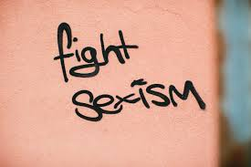
3. How can we reduce unintentional instances of gender bias when we see them happening?

Slide 22
Reduce Gender Bias - Awareness
1. Be aware that gender stereotypes might be activated – especially in situations when there are fewer women than men. (Group projects)
Notes:
How about Jason be the notetaker and Juanita be the leader?”

Slide 23
Reduce Gender Bias: Redirect
2. If you see something happening that reflects gender bias, find a non-confrontational way to re-direct and reset.
Notes:
How about Jason be the notetaker and Juanita be the leader?”

Slide 24
Examples of redirecting
“How about Jason be the notetaker and Juanita be the leader?”
“Emily, you had a really great idea earlier about coding. Could you repeat it?”
Notes:
PRACTICE ASK Them to genenate some

Slide 25
Monica, Kyle and Tom are assigned to a group project in statistics. They had to take the analyses they performed and put it into a graph. Tom says “Let’s use a pie chart. I think they are the most logical choice, and they are the easiest.” Monica says “Um, I actually think a line graph is what we want because the data is showing changes over time. So I think that is what would look the best.” Tom says “Look, I don’t think it matters what graph we pick. And I honestly don’t care if it ‘looks pretty’. Let’s just finish this.”
What gender stereotypes might have been automatically activated?
Imagine that you are Kyle. What are some things you could say that could reduce the bias?

Slide 26
You just learned -
1. Describe how gender stereotypes are activated automatically and unintentionally
2. Recognize and identify real life examples of gender bias in STEM
3. Practice how to respond to and reduce instances of gender bias

Slide 27
IDENTIFYING AND REDUCING GENDER BIAS IN STEM
Dr. Matthew Paolucci Callahan (Psychology)
Dr. Lynn Cominsky (Physics and Astronomy)

